Slide 1

SPARK

Slide 2
CONTENTS
Transformations
Actions
Shared Variables

Slide 3
Transformations
RDD Transformations are Spark operations when executed on RDD, it results in a single or multiple new RDD’s.
Since RDD are immutable in nature, transformations always create new RDD without updating an existing one hence, this creates an RDD lineage.
RDD Lineage is also known as the RDD operator graph or RDD dependency graph.

Slide 4
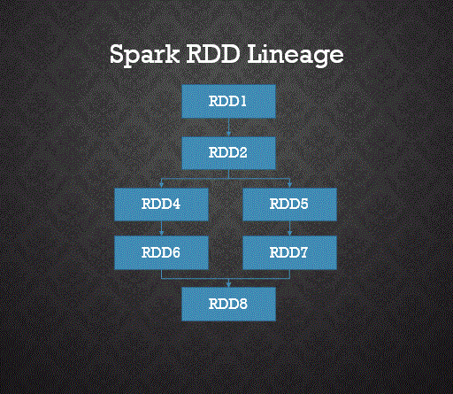

Slide 5
RDD Transformations are Lazy
RDD Transformations are lazy operations meaning none of the transformations get executed until you call an action on Spark RDD.
Since RDD’s are immutable, any transformations on it result in a new RDD leaving the current one unchanged.

Slide 6
RDD Transformation Types
There are two types are transformations.
1. Narrow Transformation
Narrow transformations are the result of map() and filter() functions and these compute data that live on a single partition meaning there will not be any data movement between partitions to execute narrow transformations.
Functions such as map(), mapPartition(), flatMap(), filter(), union() are some examples of narrow transformation

Slide 7
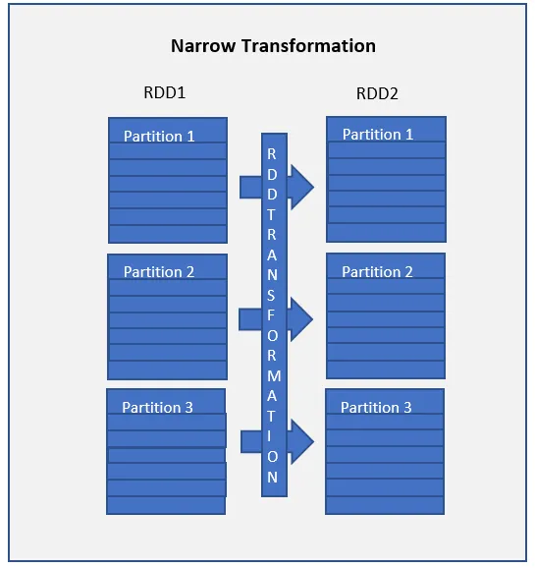

Slide 8
2. Wider Transformation
Wider transformations are the result of groupByKey() and reduceByKey() functions and these compute data that live on many partitions meaning there will be data movements between partitions to execute wider transformations. Since these shuffles the data, they also called shuffle transformations.
Functions such as groupByKey(), aggregateByKey(), aggregate(), join(), repartition() are some examples of a wider transformations.

Slide 9
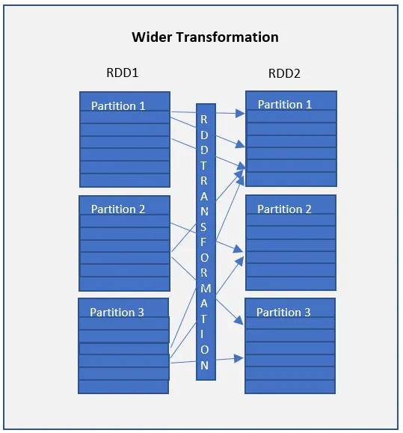

Slide 10
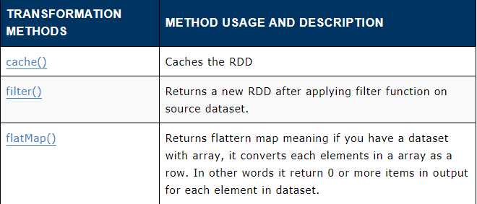
Transformation functions

Slide 11
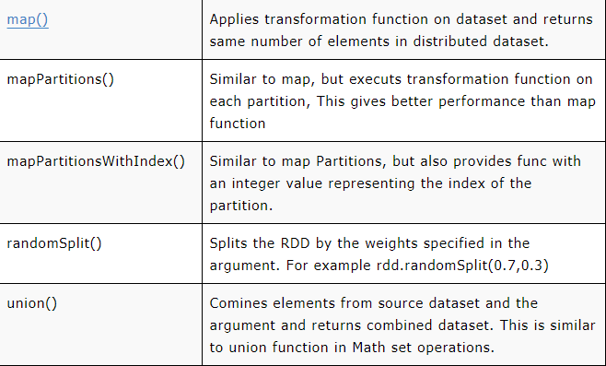

Slide 12
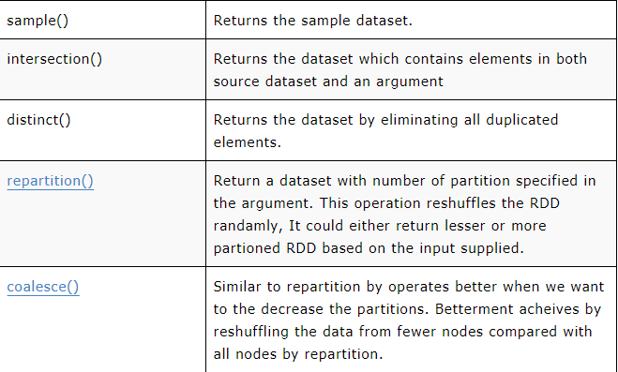

Slide 13
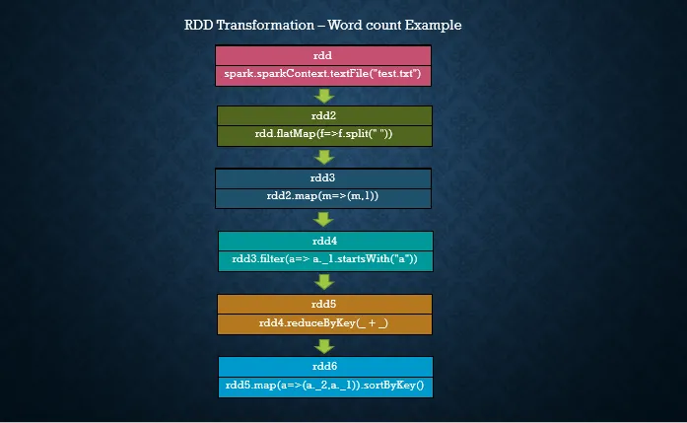
Transformations with Examples

Slide 14

Let’s create an RDD by reading a text file.
flatMap() Transformation
flatMap() transformation flattens the RDD after applying the function and returns a new RDD.
On the below example, first, it splits each record by space in an RDD and finally flattens it. Resulting RDD consists of a single word on each record.

Slide 15
map() Transformation
map() transformation is used the apply any complex operations like adding a column, updating a column e.t.c, the output of map transformations would always have the same number of records as input.
In our word count example, we are adding a new column with value 1 for each word, the result of the RDD is PairRDDFunctions which contains key-value pairs, word of type String as Key and 1 of type Int as value. For your understanding, I’ve defined rdd3 variable with type.

Slide 16

filter() Transformation
filter() transformation is used to filter the records in an RDD. In our example we are filtering all words starts with “a”.
reduceByKey() Transformation
reduceByKey() merges the values for each key with the function specified.
In our example, it reduces the word string by applying the sum function on value. The result of our RDD contains unique words and their count.

Slide 17
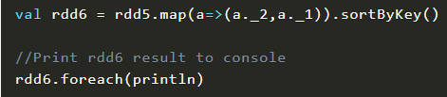
sortByKey() Transformation
sortByKey() transformation is used to sort RDD elements on key.
In our example, first, we convert RDD[(String,Int]) to RDD[(Int,String]) using map transformation and apply sortByKey which ideally does sort on an integer value.
And finally, foreach with println statement prints all words in RDD and their count as key-value pair to console.

Slide 18
Actions
RDD actions are operations that return the raw values.
In other words, any RDD function that returns other than RDD[T] is considered as an action in spark programming.

Slide 19
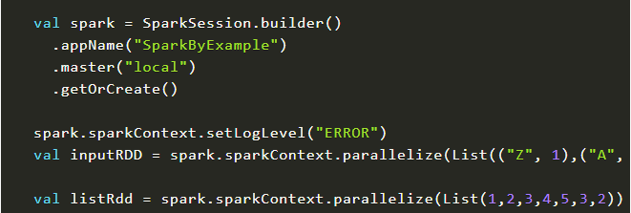
Actions Example
Before we start explaining RDD actions with examples, first, let’s create an RDD.
Note that we have created two RDD’s in the above code snippet and we use these two as and when necessary to demonstrate the RDD actions.

Slide 20
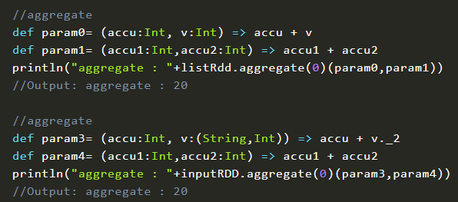
aggregate
aggregate() the elements of each partition, and then the results for all the partitions.

Slide 21
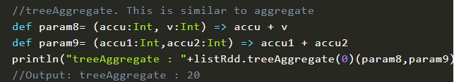
treeAggregate
treeAggregate() – Aggregates the elements of this RDD in a multi-level tree pattern. The output of this function will be similar to the aggregate function.

Slide 22
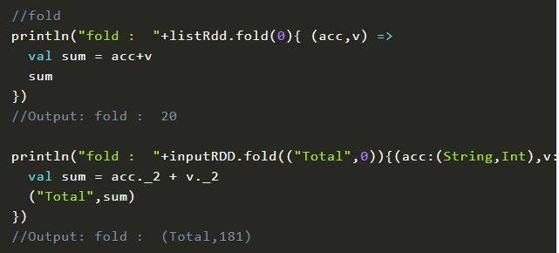
fold
fold() – Aggregate the elements of each partition, and then the results for all the partitions.

Slide 23
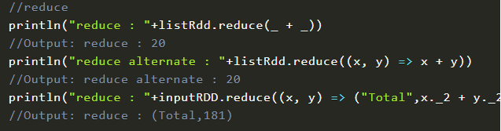
reduce
reduce() – Reduces the elements of the dataset using the specified binary operator.

Slide 24

treeReduce
treeReduce() – Reduces the elements of this RDD in a multi-level tree pattern.

Slide 25

collect
collect() -Return the complete dataset as an Array.

Slide 26
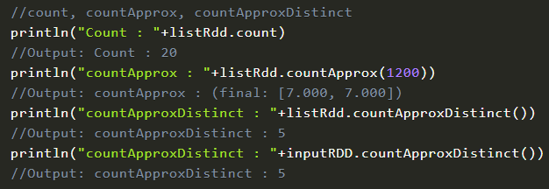
count, countApprox, countApproxDistinct
count() – Return the count of elements in the dataset.
countApprox() – Return approximate count of elements in the dataset, this method returns incomplete when execution time meets timeout.
countApproxDistinct() – Return an approximate number of distinct elements in the dataset.

Slide 27
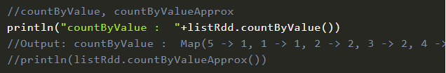
countByValue, countByValueApprox
countByValue() – Return Map[T,Long] key representing each unique value in dataset and value represents count each value present.
countByValueApprox() – Same as countByValue() but returns approximate result.

Slide 28
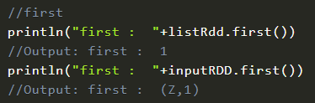
first
first() – Return the first element in the dataset.

Slide 29
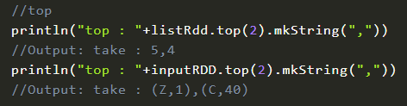
top
top() – Return top n elements from the dataset.
Use this method only when the resulting array is small, as all the data is loaded into the driver’s memory.

Slide 30
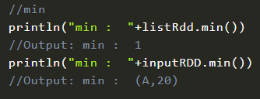
min
min() – Return the minimum value from the dataset.

Slide 31
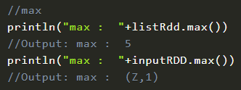
max
max() – Return the maximum value from the dataset.

Slide 32
take, takeOrdered, takeSample
take() – Return the first num elements of the dataset.
takeOrdered() – Return the first num (smallest) elements from the dataset and this is the opposite of the take() action.
Note: Use this method only when the resulting array is small, as all the data is loaded into the driver’s memory.
takeSample() – Return the subset of the dataset in an Array.
Note: Use this method only when the resulting array is small, as all the data is loaded into the driver’s memory.

Slide 33
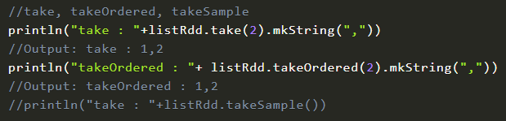
RDD actions are operations that return non-RDD values, since RDD’s are lazy they do not execute the transformation functions until we call actions.
Hence, all these functions trigger the transformations to execute and finally returns the value of the action functions to the driver program.

Slide 34
Shared Variables
In Spark, when any function passed to a transformation operation, then it is executed on a remote cluster node.
It works on different copies of all the variables used in the function.
These variables are copied to each machine, and no updates to the variables on the remote machine are revert to the driver program.

Slide 35
Broadcast variable
The broadcast variables support a read-only variable cached on each machine rather than providing a copy of it with tasks.
Spark uses broadcast algorithms to distribute broadcast variables for reducing communication cost.
The execution of spark actions passes through several stages, separated by distributed "shuffle" operations.
Spark automatically broadcasts the common data required by tasks within each stage. The data broadcasted this way is cached in serialized form and deserialized before running each task.

Slide 36
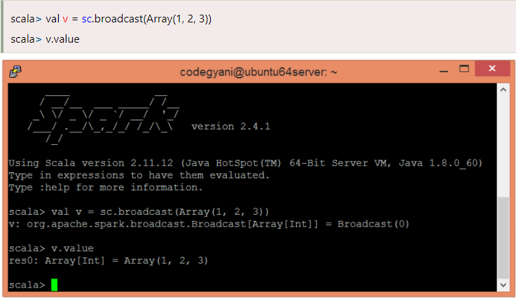
To create a broadcast variable (let say, v), call SparkContext.broadcast(v).
Let's understand with an example.

Slide 37
Accumulator
The Accumulator are variables that are used to perform associative and commutative operations such as counters or sums.
The Spark provides support for accumulators of numeric types. However, we can add support for new types.
To create a numeric accumulator, call SparkContext.longAccumulator() or SparkContext.doubleAccumulator() to accumulate the values of Long or Double type.

Slide 38
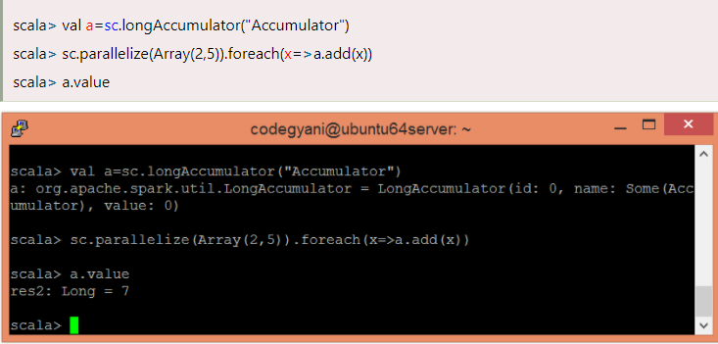

Slide 39

PySpark
Apache Spark is a lightning fast real-time processing framework.
It does in-memory computations to analyze data in real-time. It came into picture as Apache Hadoop MapReduce was performing batch processing only and lacked a real-time processing feature.
Hence, Apache Spark was introduced as it can perform stream processing in real-time and can also take care of batch processing.

Slide 40
Apart from real-time and batch processing, Apache Spark supports interactive queries and iterative algorithms also.
Apache Spark has its own cluster manager, where it can host its application.
It leverages Apache Hadoop for both storage and processing. It uses HDFS (Hadoop Distributed File system) for storage and it can run Spark applications on YARN as well.

Slide 41
END OF SESSION
Q&A

